Slide 1
MOVIE RECOMMENDATION SYSTEM
USING UNSUPERVISED MACHINE LEARNING ALGORITHMS

Slide 2
WHAT IS A RECOMMENDATION SYSTEM?
A SYSTEM WHICH CAPTURES PATTERNS OF PEOPLE’S BEHAVIOUR AND USE IT TO PREDICT WHAT ELSE THEY WANT OR LIKE.

Slide 3
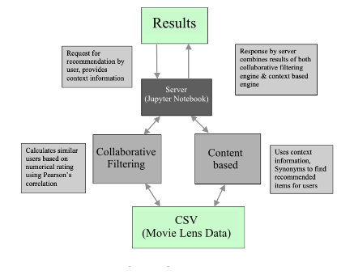
SYSTEM ARCHITECTURE OF RECOMMENDATION SYSTEM IN THIS PROJECT

Slide 4
TYPES OF RECOMMENDER SYSTEMS
CONTENT BASED RECOMMENDER SYSTEM
THESE RECOMMENDER SYSTEM SHOW RECOMMENDATIONS AS PER USER CHOICE SIMILARITY. FOR EG – A USER RECOMMENDATION OF A MOVIE BASED ON GENRE, I.E. - COMEDY, ADVENTURE, DRAMA, ETC.
COLLABORATIVE FILTERING BASED RECOMMENDER SYSTEM
THESE RECOMMENDATION SYSTEM SHOW RECOMMENDATIONS AS PER NEIGHBOURHOOD POPULARITY OR TRENDING CHOICE CRITERIA. FOR EG – A USER RECOMMENDATION OF A MOVIE BASED ON LATEST CINEMA CHOICES IN THE SAME NEIHBOURHOOD OR AREA.

Slide 5
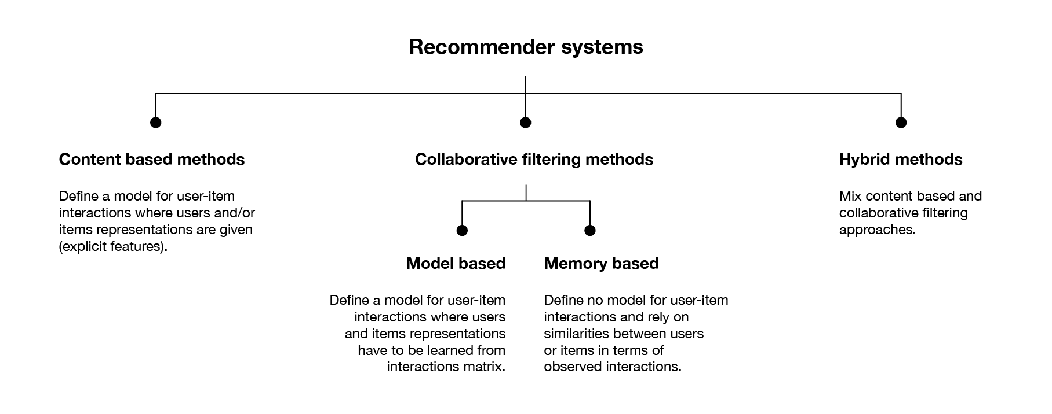

Slide 7
CONTENT BASED RECOMMENDER SYSTEM
MEMORY BASED
MODEL BASED
THERE IS AVAILABILITY OF USER-ITEM DATASET.
IT USES STATISTICAL TECHNIQUES TO APPROXIMATE USERS OR ITEMS
EXAMPLE - PEARSON CORRELATION, COSINE SIMILARITY, EUCLIDEAN DISTANCE.
THERE IS NO AVAILABILITY OF ANY DATASET OF USER RATINGS.
IT USES MODEL WHICH LEARNS USER PREFERENCES AND PROVIDES THE RECOMMENDATIONS.
EXAMPLE – USING MACHINE LEARNING ALGORITHMS SUCH AS REGRESSION,CLASSIFICATION & CLUSTERING.

Slide 9
COLLABORATIVE FILTERING BASED RECOMMENDER SYSTEM
USER BASED
ITEM BASED
BASED ON USER’S SIMILARITY OR NEIHBOURHOOD
THERE IS AN ACTIVE USER FOR WHOM THE RECOMMENDATION IS AIMED.
HISTORY, PREFERENCES & CHOICES OF ACTIVE_USER IS COMPARED TO OTHER USERS IN THE SAME NEIGHBOURHOOD.
BASED ON ITEM’S SIMILARITY
SIMILAR ITEMS BUILD NEIGHBOURHOOD ON THE BEHAVIOUR OF THE USERS.
IT DOES NOT USE MOVIE’S CONTENT TO COMPARE THE USER ACTIVITY.

